Slide 1
Computer Vision Fundamentals
Lecture 3 - Part 1
Manipulating images in MATLAB

Slide 2
Contents
Direct Render
Reading and displaying images
Getting file information
Image type conversions

Slide 3

Direct Render
We could display this image directly, without saving its grey values to a matrix, with the command
>> imshow(‘ned.png’);

Slide 4
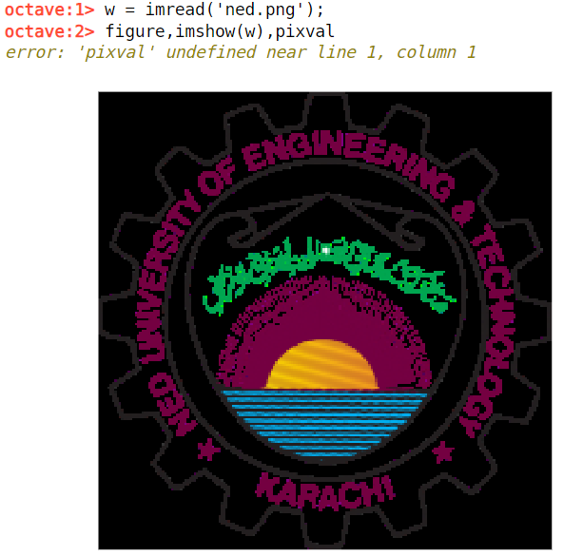
Reading & Displaying Images
Let’s see how the matrix capabilities of Matlab allow us to investigate images and their properties.
>> w=imread(‘ned.png’);
Now we can display this matrix as a grayscale image
>> figure,imshow(w),pixval on

Slide 5
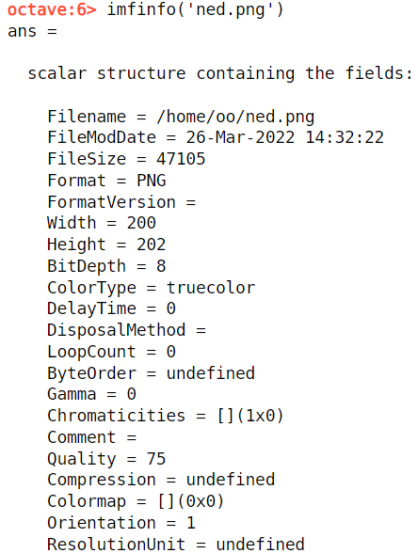
Getting file information
A great deal of information can be obtained with the imfinfo function. For example, suppose we take our indexed image ned.png from above.
>> imfinfo(’ned.png’);

Slide 6
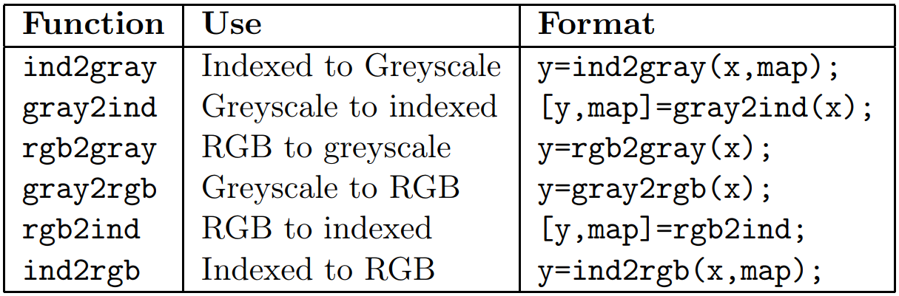
Image type conversions
We can convert images from one image type to another. Table lists all of Matlab functions for converting between different image types

Slide 7
Thankyou

